Slide 1
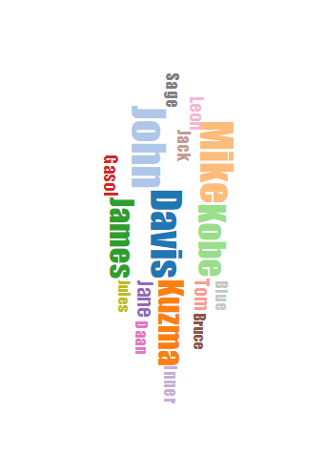
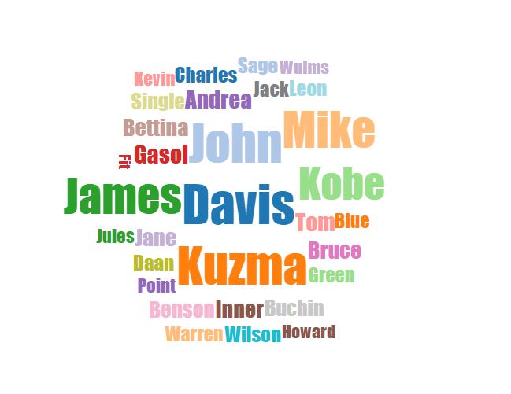
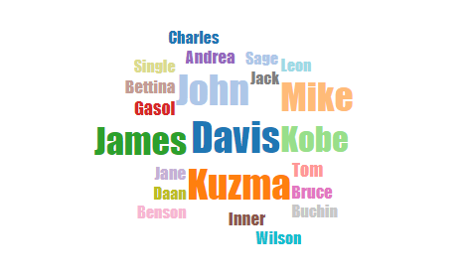
Responsive Wordle

Slide 2

INTRODUCTION
Background & Overview
CONTENTS
METHODS
Words Attribute & Force Re-Layout
RESULTS
Responsive Wordle Demo

Slide 3

01
INTRODUCTION
Background & Overview

Slide 4

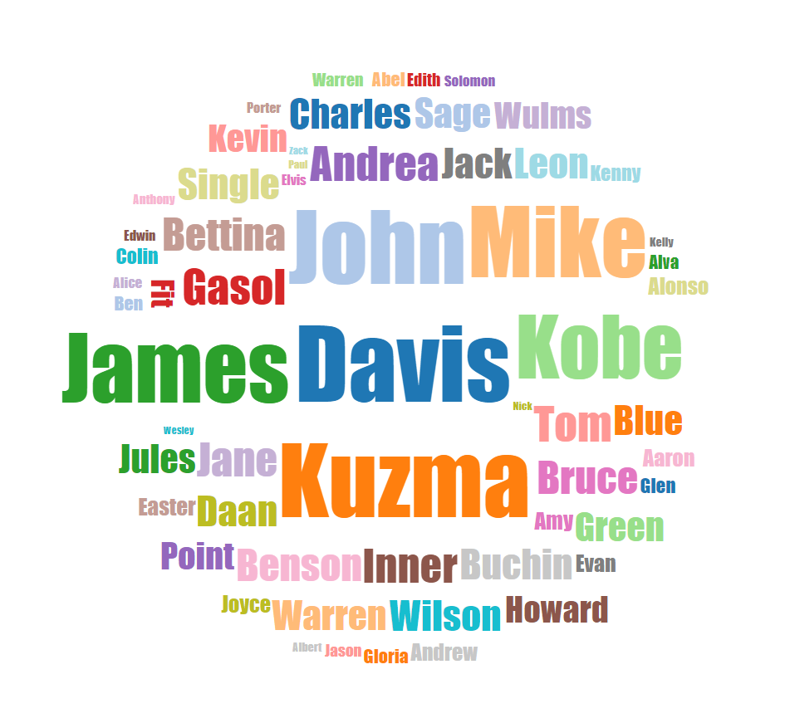
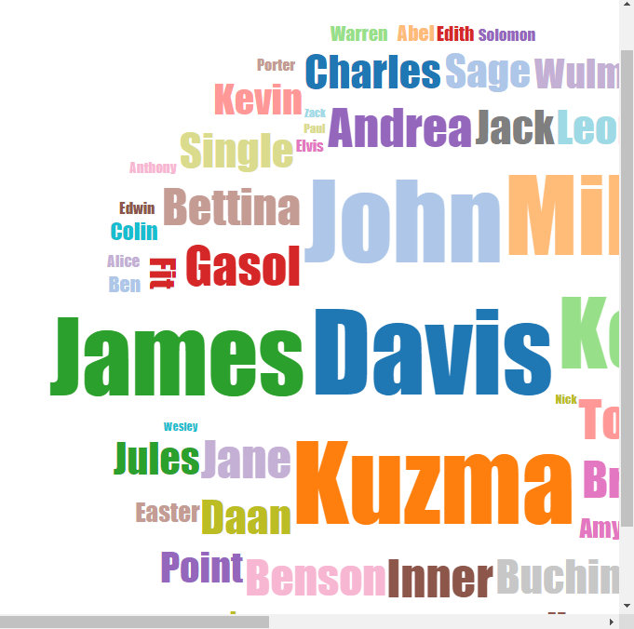
Why Responsive
With the continuous popularity of Wordles on social media, a number of tools have emerged, such as WordArt and Tagxedo, which allow people to create Wordles in a certain shape by fitting words into it.
However, the results do not achieve a high fill rate and high data fidelity at the same time and these tools do not provide manipulation capabilities. So, we introduce Shape Wordle : a new technique that not only allows people to generate shape-bounded Wordles but also priovide interactive editing.
change the screen size
Wordle can not change with screen size ! !

Slide 5
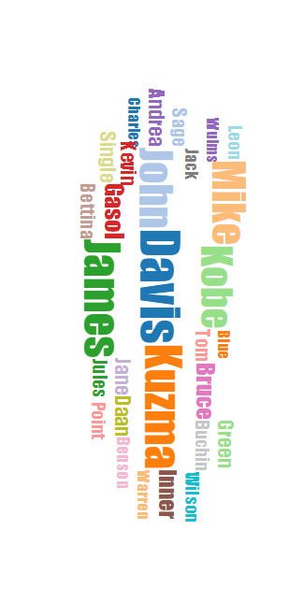
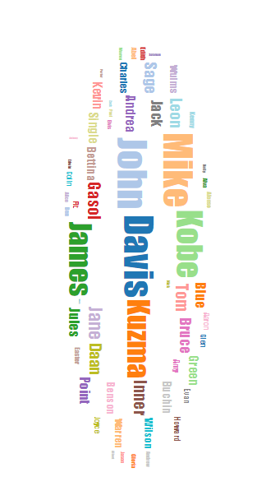
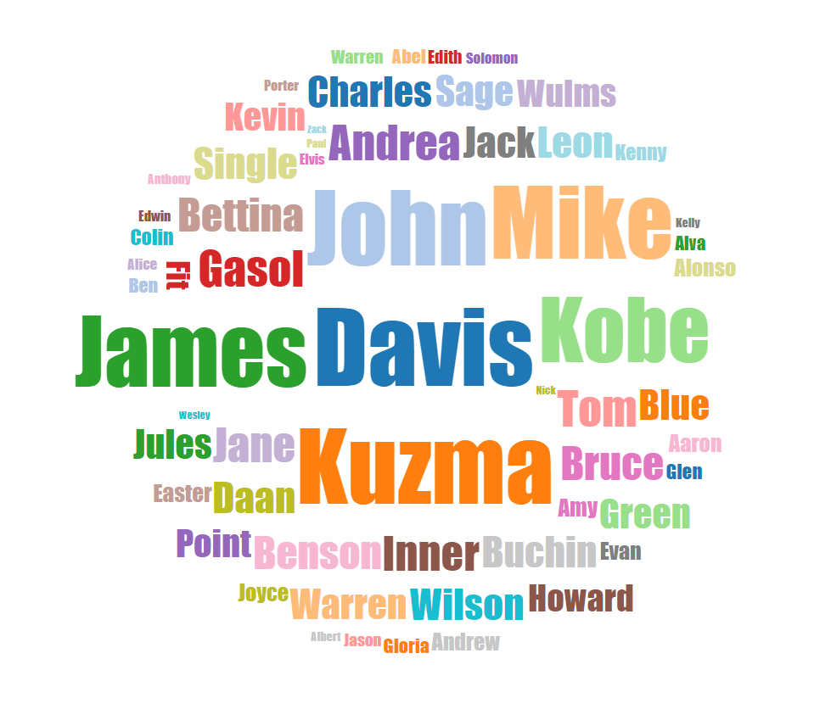
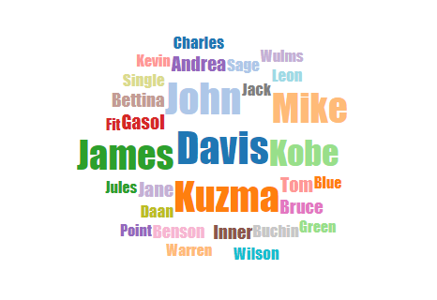
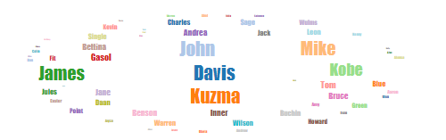
Methods Overview
Force Layout Constraint & Filter
Word Attribute Constraint
Word Attribute Constraint
Force Layout Constraint & Filter

Slide 6
02
METHODS
Words Attribute & Force Re-Layout

Slide 7
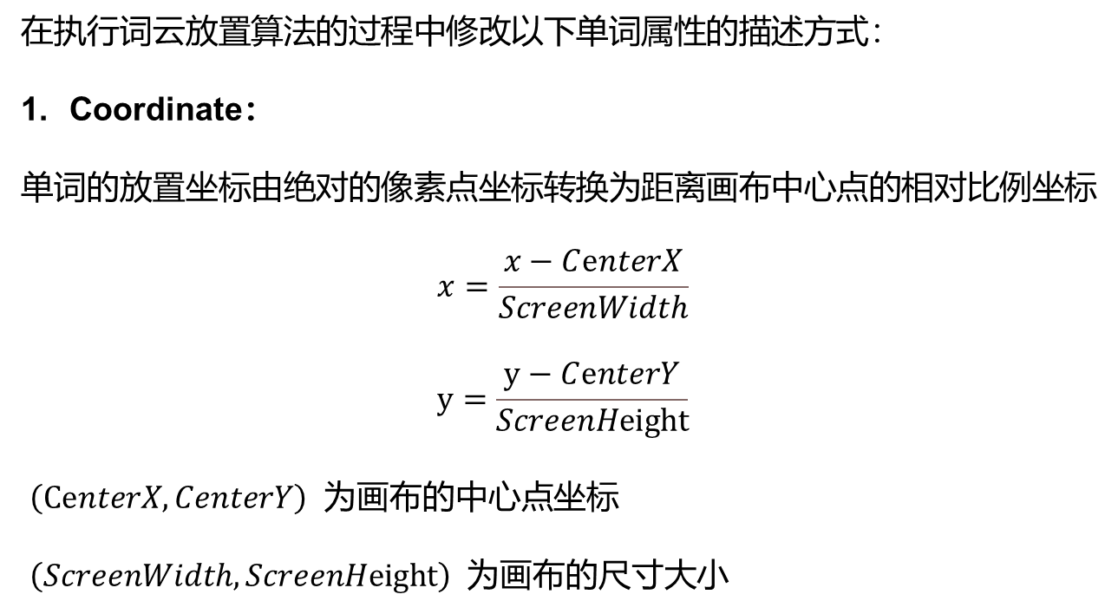
Words Attribute Constraint
在执行词云放置算法的过程中修改以下单词属性的描述方式：
Coordinate：
单词的放置坐标由绝对的像素点坐标转换为距离画布中心点的相对比例坐标
$$x=\frac{x−CⅇnterX}{ScreenWidth}$$
$$y=\frac{y−CⅇnterY}{ScreenHeight}$$
$\left(CⅇnterX,CenterY\right)$ 为画布的中心点坐标
$\left(ScreenWidth,ScreenHeight\right)$ 为画布的尺寸大小

Slide 8
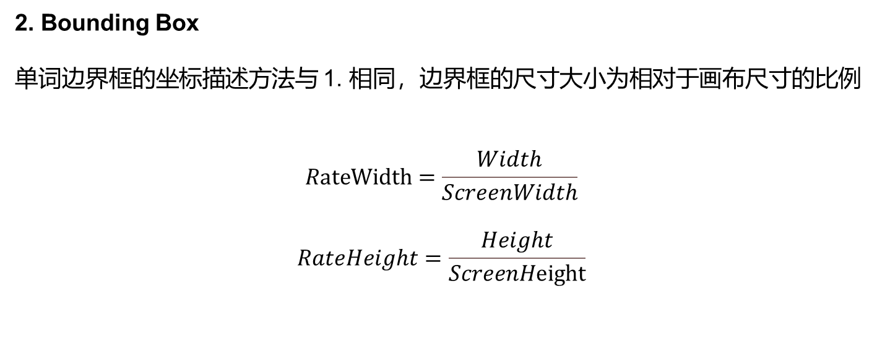
Words Attribute Constraint
2. Bounding Box
单词边界框的坐标描述方法与 1. 相同，边界框的尺寸大小为相对于画布尺寸的比例
$$RateWidth=\frac{Width}{ScreenWidth}$$
$$RateHeight=\frac{Height}{ScreenHeight}$$

Slide 9
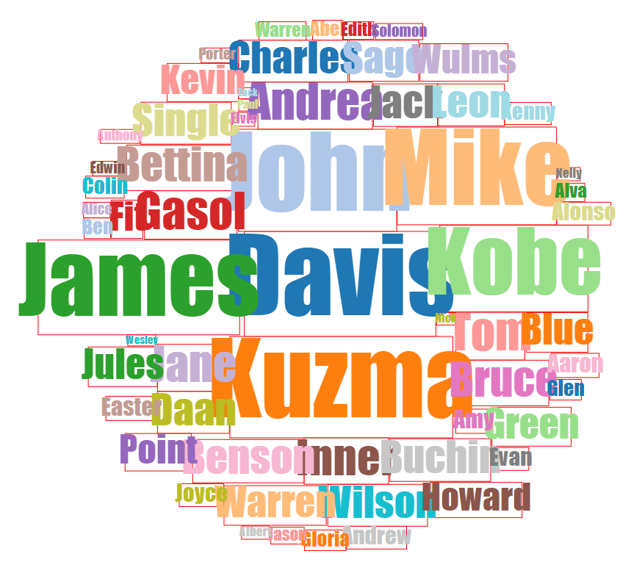
Words Attribute Constraint
After 1. 2.
Why Overlapping?
由于 Font-Size 的单位是像素点，所以乘以相应屏幕尺寸的比例因子后的计算结果需取整，因此单词大小的变化比例与单词边界框的变化比例存在偏差，从而导致了左图这样的情况。
3. Font Size
为了解决上述问题，我们在绘图前对比例化后的单词列表进行预处理，迭代调整 Font-Size 的大小，
保证每个单词能够正确地被边界框所包围。

Slide 10
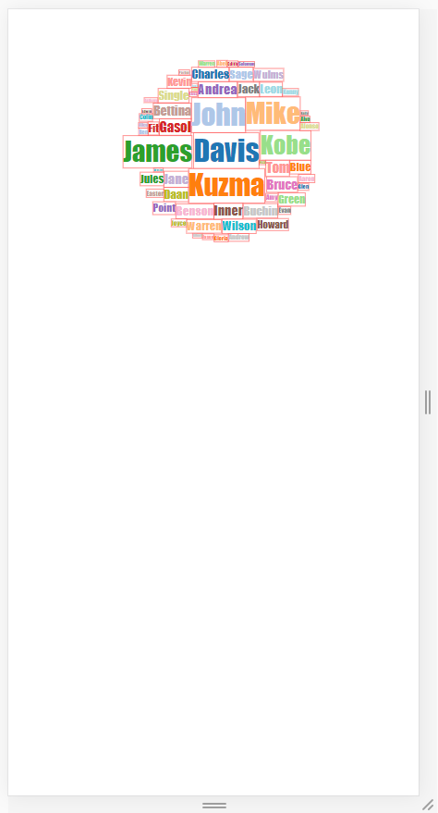
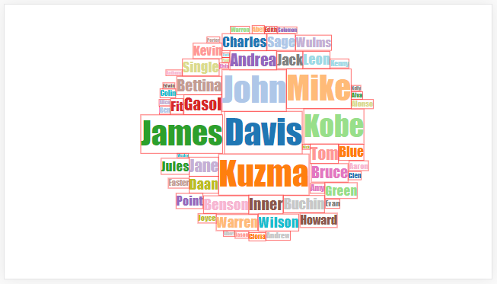
Words Attribute Constraint
After 1. 2. 3.
Vertical screen
Horizontal screen
It looks good！！
Wordle takes up too little of the screen ！!

Slide 11
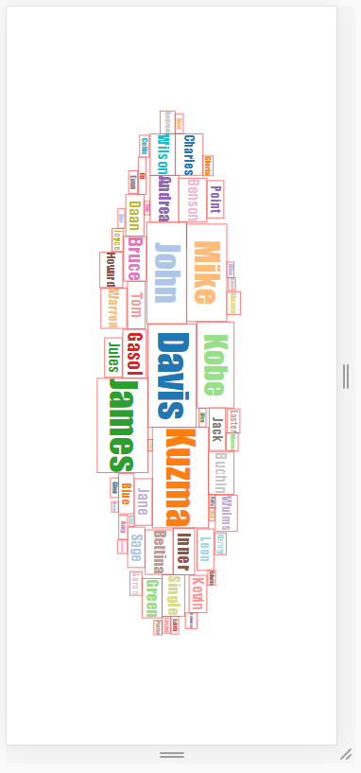
Words Attribute Constraint
4. Rotation
从前面的图中可以看出，在竖屏情况下，词云占据屏幕空间的比例很小，视觉效果较差
为了在不改变原有布局的前提下解决该问题，可以让单词自适应式旋转，修改后效果如下：
Responsive Rotation

Slide 12
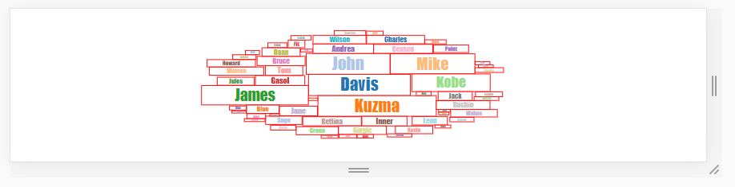
Still Some Problems
由于我们前面对 Font-Size 的处理方法只是简单地将单词限制在其边界框内，所以会
出现如上图所示的情况，单词之间的间隔很大，并不能达到紧凑的布局效果，同时由
于单词的大小随着屏幕的缩小而缩小，最终会被缩放到肉眼难以分辨，严重影响视觉
效果，因此我们仍需额外的解决方案：Force Re-Layout

Slide 13
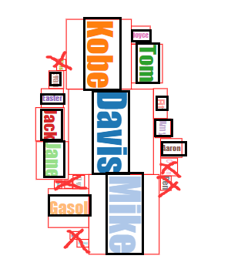
Force Re-Layout
Filter and Re-shape the bounding box
红色叉号表示被过滤掉的单词
黑色矩形表示新的单词边界框

Slide 14
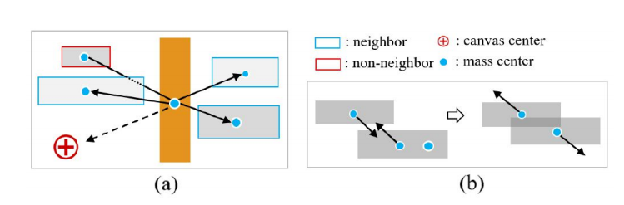
Force Re-Layout
To produce a compact layout while preserving the neighborhood, we apply two external forces to the objects: neighboring forces and central forces. While the former pushes neighboring words close to each other, the latter drags all words to the canvas center.
2. Neighborhood Search
The body center of each word is connected to the centers of all other words. If the line segment connecting two words does not intersect a third word, these two words are considered to be neighbors.

Slide 15
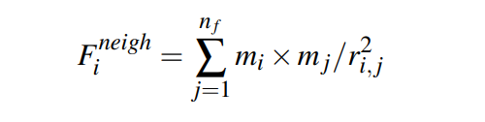
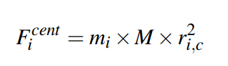
Force Re-Layout
3. Neighboring Forces
where $r_{i,j}$is the Euclidean distance between the body centers of the selected word $i$and the $n$ neighbor words $j$. The mass $m$ is a given weighting factor for each word.
4. Central Forces
where $M$ is a unit mass, and $r_{i,c}$ is the distance between word $i$ and the screen center.

Slide 16


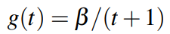
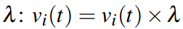
Force Re-Layout
5. Joining the Forces
6. Damping Strategy
More details in http://irc.cs.sdu.edu.cn/~yunhai/infovis17/edwordle/index.html

Slide 17
03
RESULTS
Responsive Wordle Demo

Slide 18
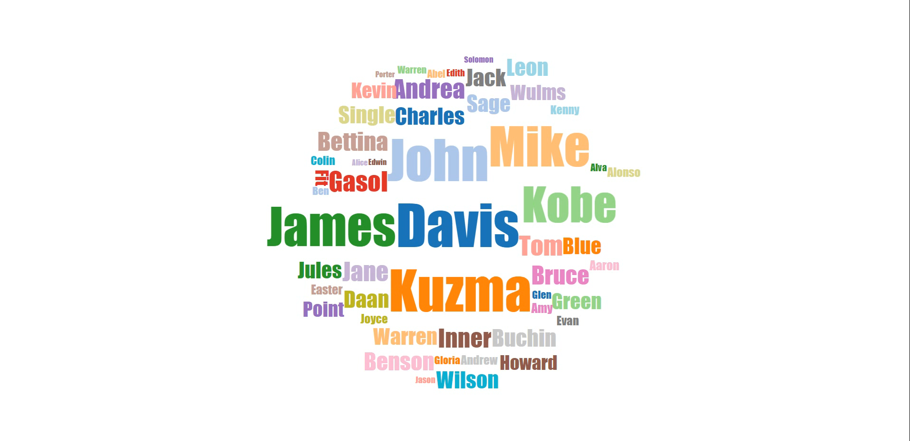
Results
Demo Video

Slide 19
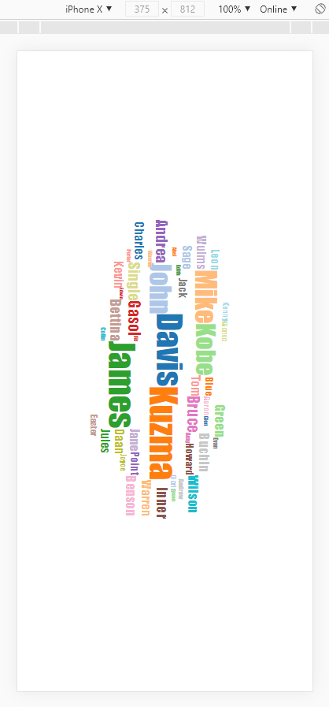
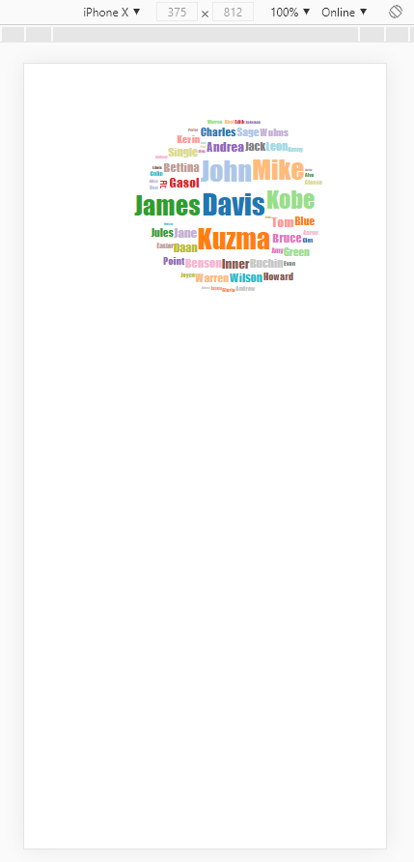
Compare With Google Chrome’s Responsive

Slide 20
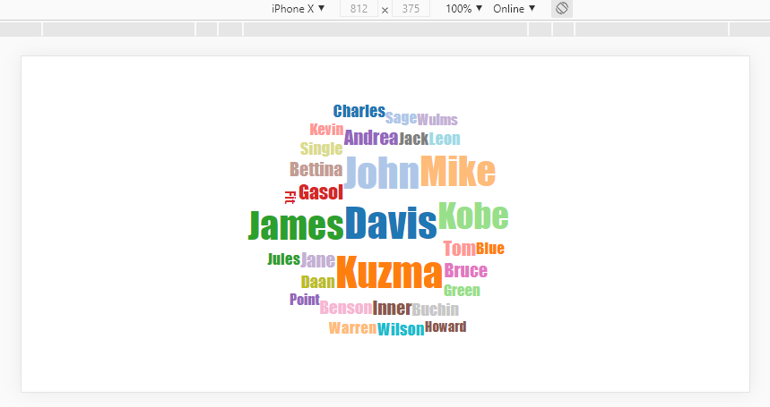
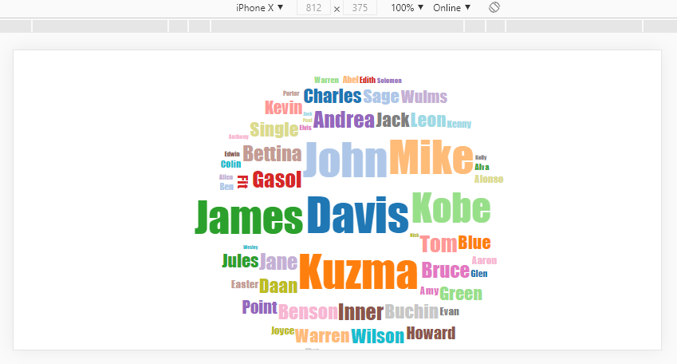
Compare With Google Chrome’s Responsive

Slide 21
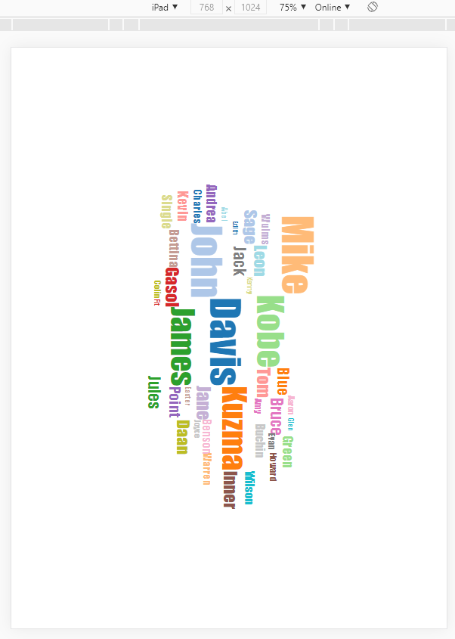
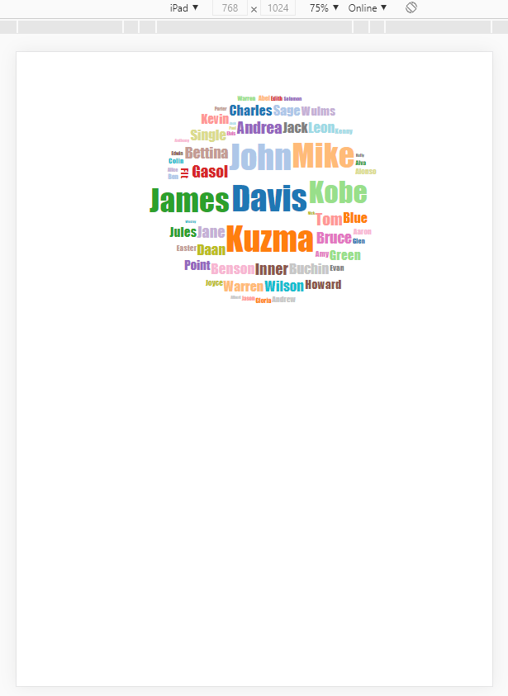
Compare With Google Chrome’s Responsive

Slide 22
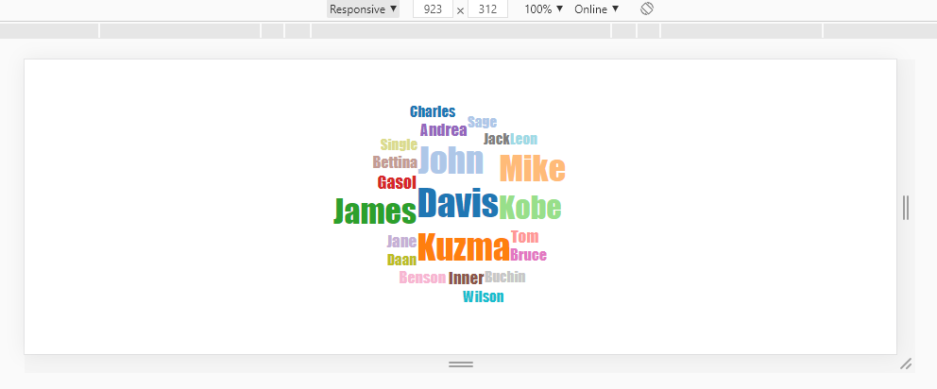
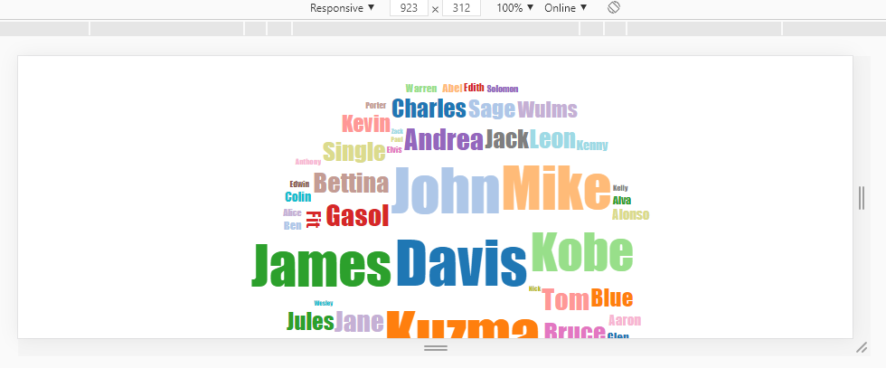
Compare With Google Chrome’s Responsive

Slide 23

Thank You!
BY：Wang Zhirui

